Slide 1
Realtime FaceMask Detection
NOORJAHAN
ID: 20-42894-1
MD. IFAJ HOSSAN OMI
ID: 20-423874-1
ASHIKUR RAHAMAN JOY
ID: 19-41174-2
NAHIDA AKTHER ASHA
ID: 19-41190-2
Group–E
SYED FAHIM SHAHARIAR
ID: 19-41236-2

Slide 2





Introduction
The topic of our minor project is face mask detector. In this project we have used OpenCV, Keras/TensorFlow, and Deep Learning. We introduce a mask face detection model that is based on computer vision and deep learning. The proposed model can be integrated with surveillance cameras to impede the COVID-19 transmission by allowing the detection of people who are wearing masks not wearing face masks. The model is integration between deep learning and classical machine learning techniques with OpenCV, tensor flow and keras.

Slide 3


Tools And Technology
1.Python
2.VS Code
3.Keras
4.Tensorflow
5. Convolutional neural network(CNN)
6. Deep learning

Slide 4
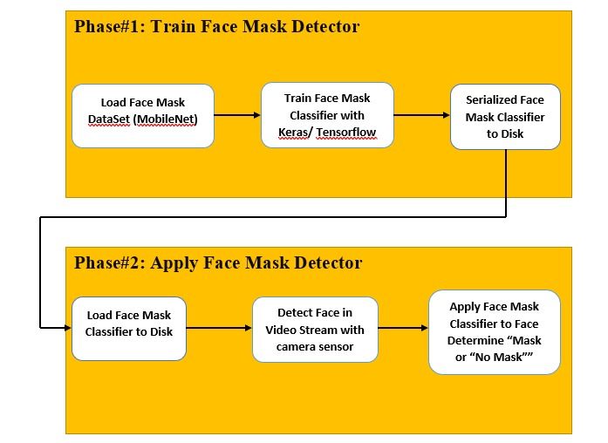
Flow Chart

Slide 5
Code Implementation

Slide 6
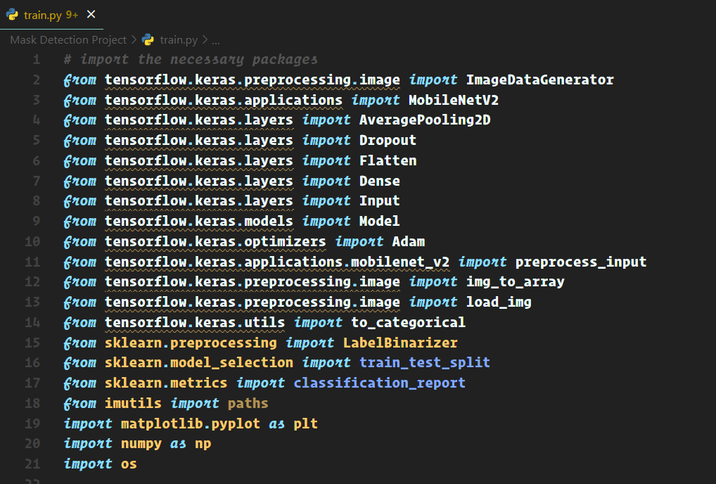
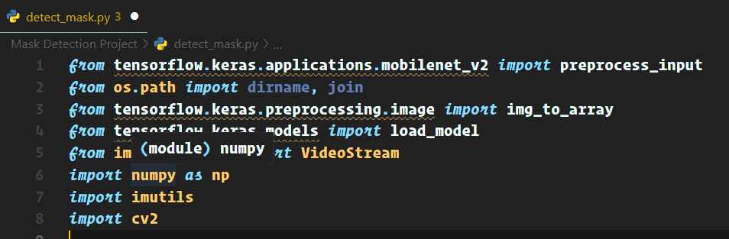
Implementation
Import the necessary packages

Slide 7
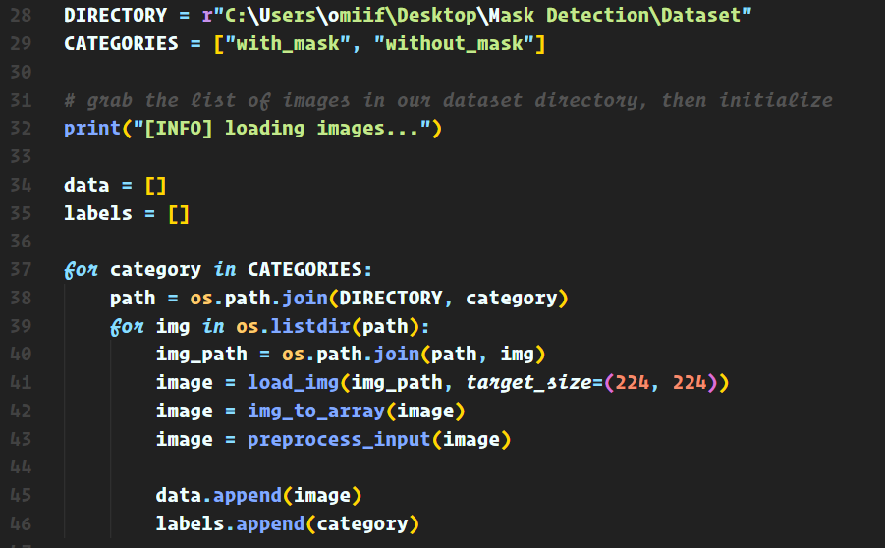
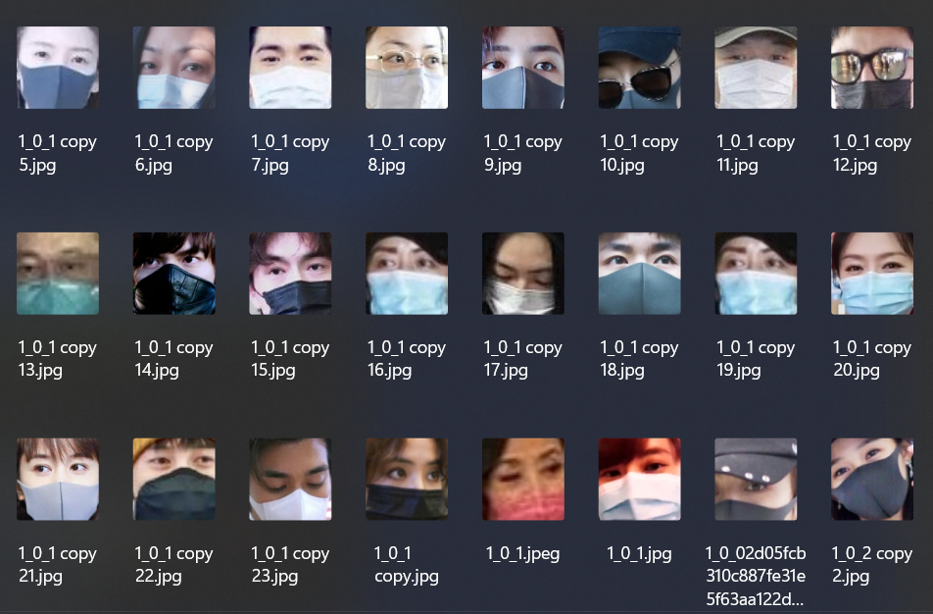
Implementation
2. Import the dataset :
Notes:
Dataset a 3800 ar beshi pic use kora hoyechey, and akta img generator create korsi jeta amader existing image guli k aro kichu ta modification korey new img create korechi

Slide 8
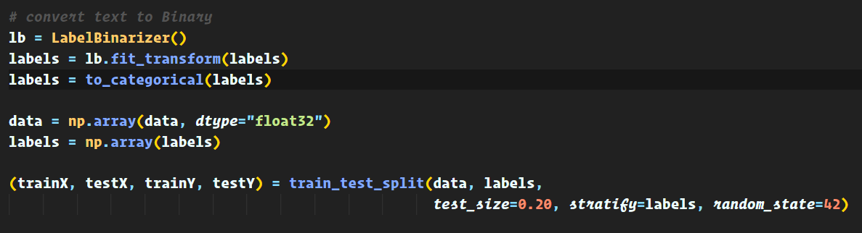
Implementation
3. Data Processing :
Notes:
Data guli k amra 1st a prepocess korechi amra amader datar level guli k numerical data tey convert korechi. Jeta agey mask no mask chilo
porey amra data guli k numpy array tey store korechi
amra total dataset ar 20% testing ar jonno use korechi
NumPy arrays are like Python's built-in list type, but NumPy arrays provide much more efficient storage and data operations as the arrays grow larger in size.

Slide 9
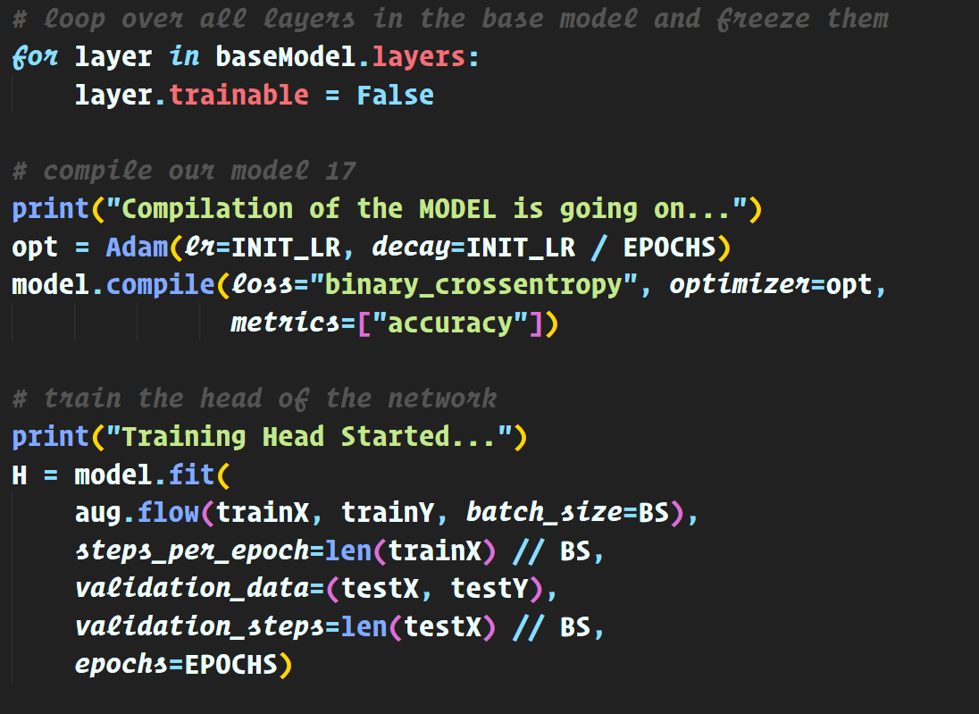
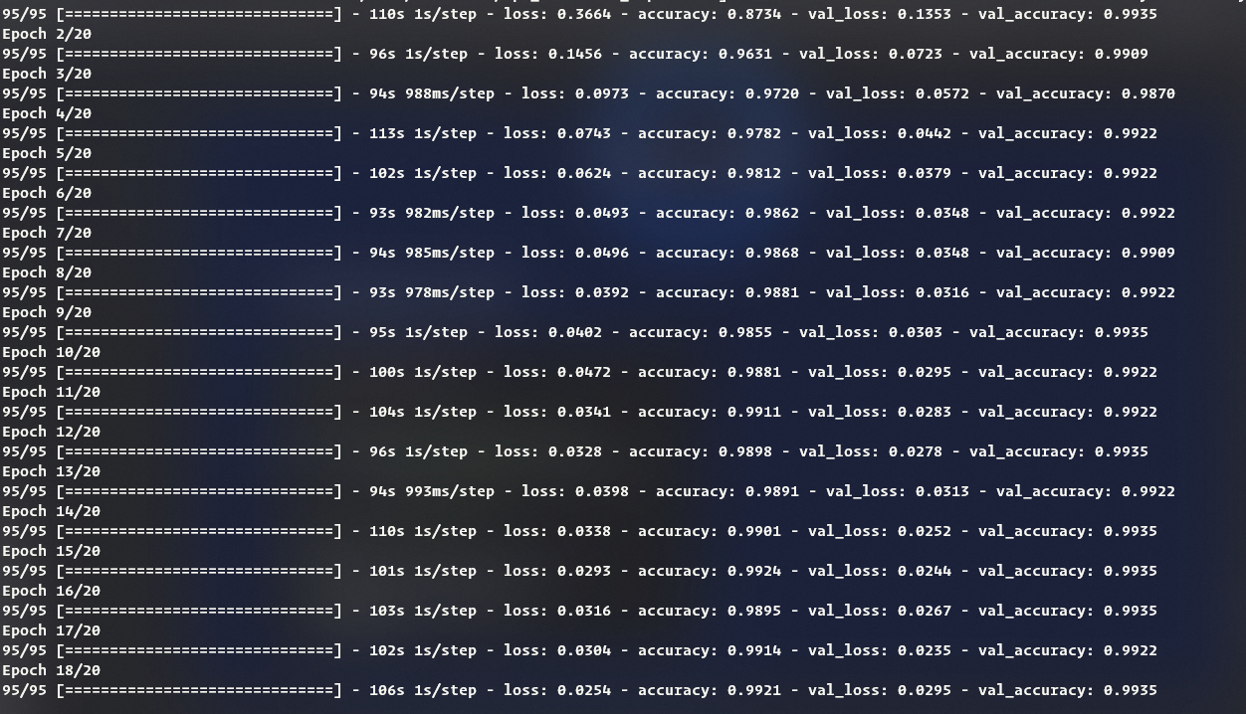
Implementation
4. Training the CNN :
Notes:
1. Amra Supervised learning korechi jehetu amader data guli leveld data chilo.
2. Akhan a mobilenet use kora hoyechey. Mobilenet conventional nural network theykey faster and less parameter use korey. Less aqurate.
3. Amader Batch size set korechi 32 and epoch size 20.

Slide 10
Result
99 %
Notes:
Last epoch ar por amra 99% accuracy peyechi

Slide 11
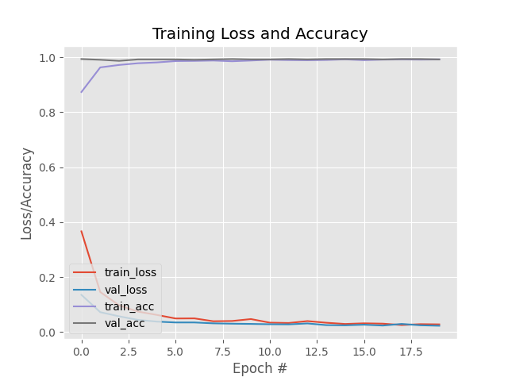
Accuracy
Notes:
Plot ar x axis a epoch and y axis a training set ar loss and accuracy. Amra dekhtey pacchi 1st ar dik ar epochs a accuracy kom chilo and loss beshi chilo but joto epochs loop hoyechey toto accuracy aro berechey

Slide 12
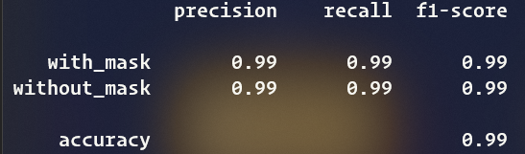
Accuracy
Notes:
Akhan a amra dekhtey parchi amader accuracy and precesion 99%

Slide 13
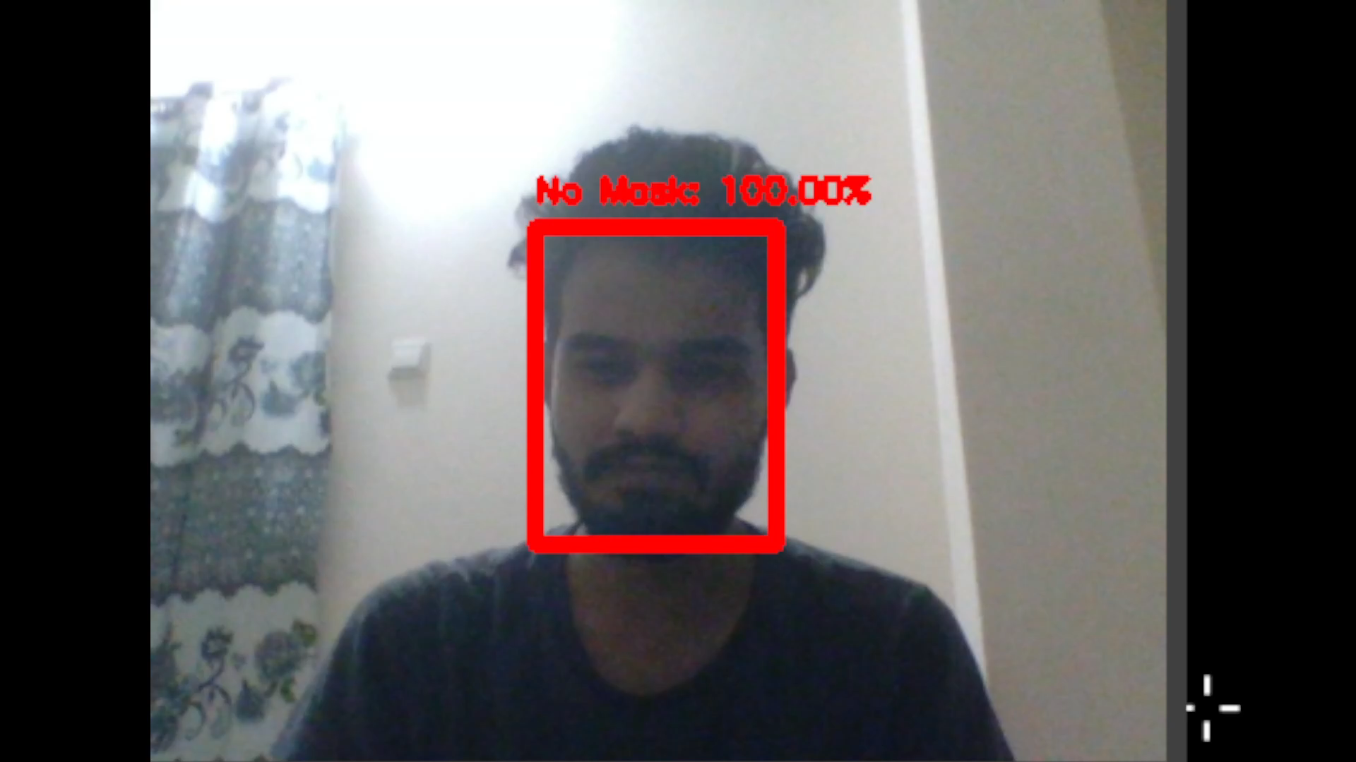
Real Time Experiment

Slide 14
Future Work
Male & Female identification
Student
Employee
Identify by CC tv camera

Slide 15
Thank
You.

